Slide 1

Market Failures
PUBLIC GOODS
2.9
Copyright Bananaomics

Slide 2


Terms to Know
Private Goods
Goods that are rivalrous and excludable.
Example: A Banana. When a banana is consumed, no one else can consume it and people can be prevented from eating it due to price.
Public Goods
Goods that are non-excludable and non-rivalrous.
Example: A highway. Everyone is able to use it freely and if you use it, you aren't preventing others from using it.
Copyright Bananaomics

Slide 3

The Problem:
How do public goods create market failures?
Copyright Bananaomics

Slide 4

ACDC ECON - PUBLIC GOODS AND FREE RIDERS
Copyright Bananaomics

Slide 5

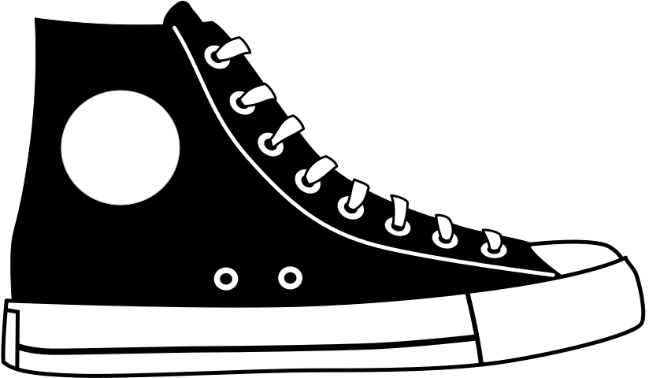

Private vs Public Goods
Private Goods
Definition
Goods and services that are simultaneously rivalrous and excludable.
Examples: Plane Tickets, Fast Food Meal, Shoes
Copyright Bananaomics

Slide 6


Private vs Public Goods
Public
Definition
Goods that are both non-rivalrous and non-excludable
Examples: Street lights, National Security, Firefighters, , Air
Copyright Bananaomics

Slide 7

The Free Rider Problem
The idea is that no one is willing to pay for non-excludable goods and services, and those individuals believe someone else will pay for these goods.
Even if the government pays for these goods using revenue from taxes, free riders still arise as not all citizens will pay their share of taxes.
Copyright Bananaomics

Slide 8
MARGINAL REVOLUTION UNIVERSITY - WHAT IS THE FREE RIDER PROBLEM?
Copyright Bananaomics

Slide 9

Quasi Public Goods
Goods that are excludable but non-rivalrous. An example is a movie theatre or toll highway
Copyright Bananaomics

Slide 10

Government Response to Public Goods
Government Provision
In most cases, the government will choose to provide the public good by using tax revenue. This helps to solve the free-rider problem to a degree.
At times, however, the government may pay companies from the private sector if more efficient.
Copyright Bananaomics

Slide 11

Enjoying The Content?
Visit bananaomics.com to purchase package deals with discount prices!
BANANAOMICS

